Slide 1
Results 2017 S1
August 21nd, 2017
Presentation by:
Mr Rik De Nolf (President of the Board)
Mr Xavier Bouckaert (CEO)
Mr Jeroen Mouton (CFO)

Slide 2
MISSION & STRATEGY
XAVIER BOUCKAERT

Slide 3

Mission and Ambition
A multimedia group creating value for
Readers
Internet surfers
TV-watchers
Radio-listeners
Telco-users
Advertisers
Sponsors & Partners
Personnel
Shareholders
Society

Slide 4


Strategy
Innovation
Vertical Integration
Diversification
M & A
Partnerships

Slide 5

Focussing on INNOVATION
  New system for TV distribution: STIEVIE
  New mobile telecom MVNO: MOBILE VIKINGS
  New sales-house Medialaan-Persgroep: NEO
  New data-team Medialaan-Persgroep: TRINITY
  New local online news service: KWESTIE
  New distribution system: DEZE WEEK

Slide 6


Focussing on DIGITAL
  STORESQUARE: E-commerce platform growing fast according to business plan
  DIGILOCAL: marketing solutions for the local advertisers via Google, Facebook, Proxistore & Proxiletter

Slide 7
Growth – biggest platform of Flanders
1 million visitors in December 2017
New look and feel
Advantages for the consumer
Advantages for the merchant
Local & SME
Netherlands
Year-end period & offline boost
Storesquare launches “Farmasquare”
Notes:
799,306,76€ voor initiële waarde van 6,412,405,32 + 9,496,418,27 PRINTING
22K op resterende waarde van 634K€ IT
=> 15,930K€ waarde voor 821K€ of 5,1%

Slide 8
Roularta in 2019
Significant drop of financing costs currently > 5 mio €
  100 million € bond is refinanced with a 47,5 mio € term loan
  47,5 mio € RCF-lines confirmed
Significant drop of leasing costs currently > 10 mio €
  The first buy-back contracts with Econocom are signed.
  Second buy-back contracts expected end of 2018.
Significant drop of telecom costs:
  Renegotiation of raw material purchase contract.
  Strong appetite in the market to sign with Mobile Vikings.
Notes:
799,306,76€ voor initiële waarde van 6,412,405,32 + 9,496,418,27 PRINTING
22K op resterende waarde van 634K€ IT
=> 15,930K€ waarde voor 821K€ of 5,1%

Slide 9
2017 Difficult year
Limited visibility on advertising income.
Launching costs in Storesquare, Mobile Vikings, Kwesties, new distribution Deze Week
Notes:
799,306,76€ voor initiële waarde van 6,412,405,32 + 9,496,418,27 PRINTING
22K op resterende waarde van 634K€ IT
=> 15,930K€ waarde voor 821K€ of 5,1%

Slide 10
2017 Opportunities
Acquisition of STERCK: 360° marketing activities with network events & publications
Launching STERCK. in all provinces of Flanders in 2018.
Media market is consolidating.
Notes:
799,306,76€ voor initiële waarde van 6,412,405,32 + 9,496,418,27 PRINTING
22K op resterende waarde van 634K€ IT
=> 15,930K€ waarde voor 821K€ of 5,1%

Slide 12
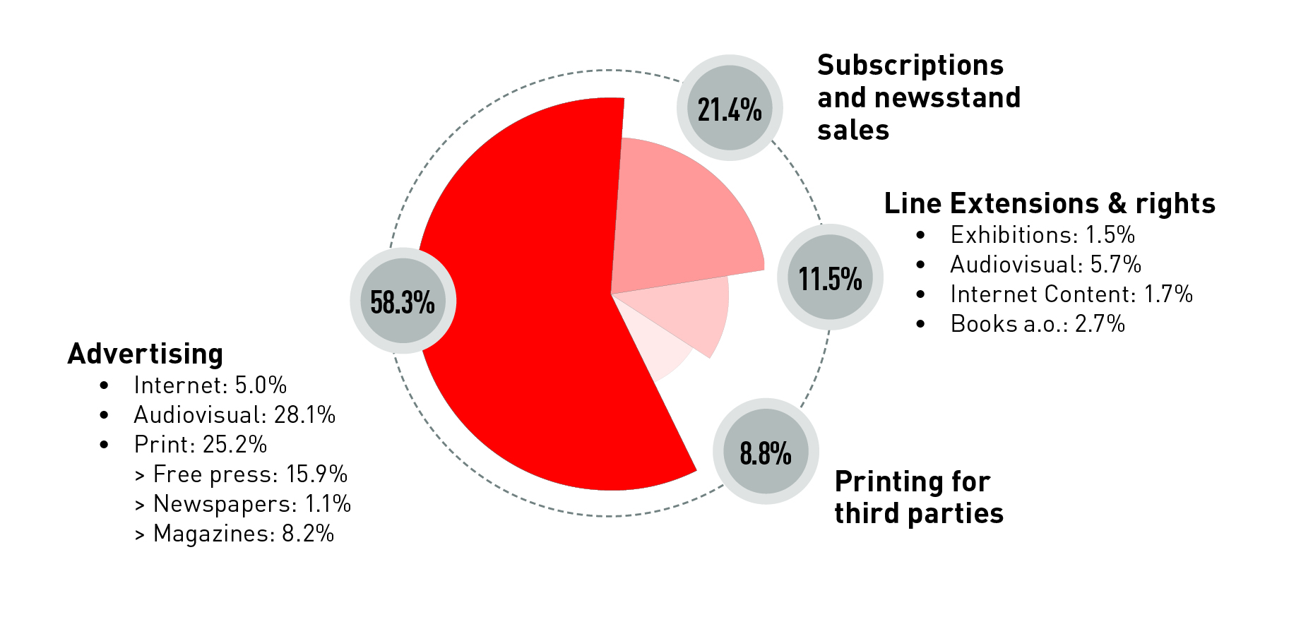
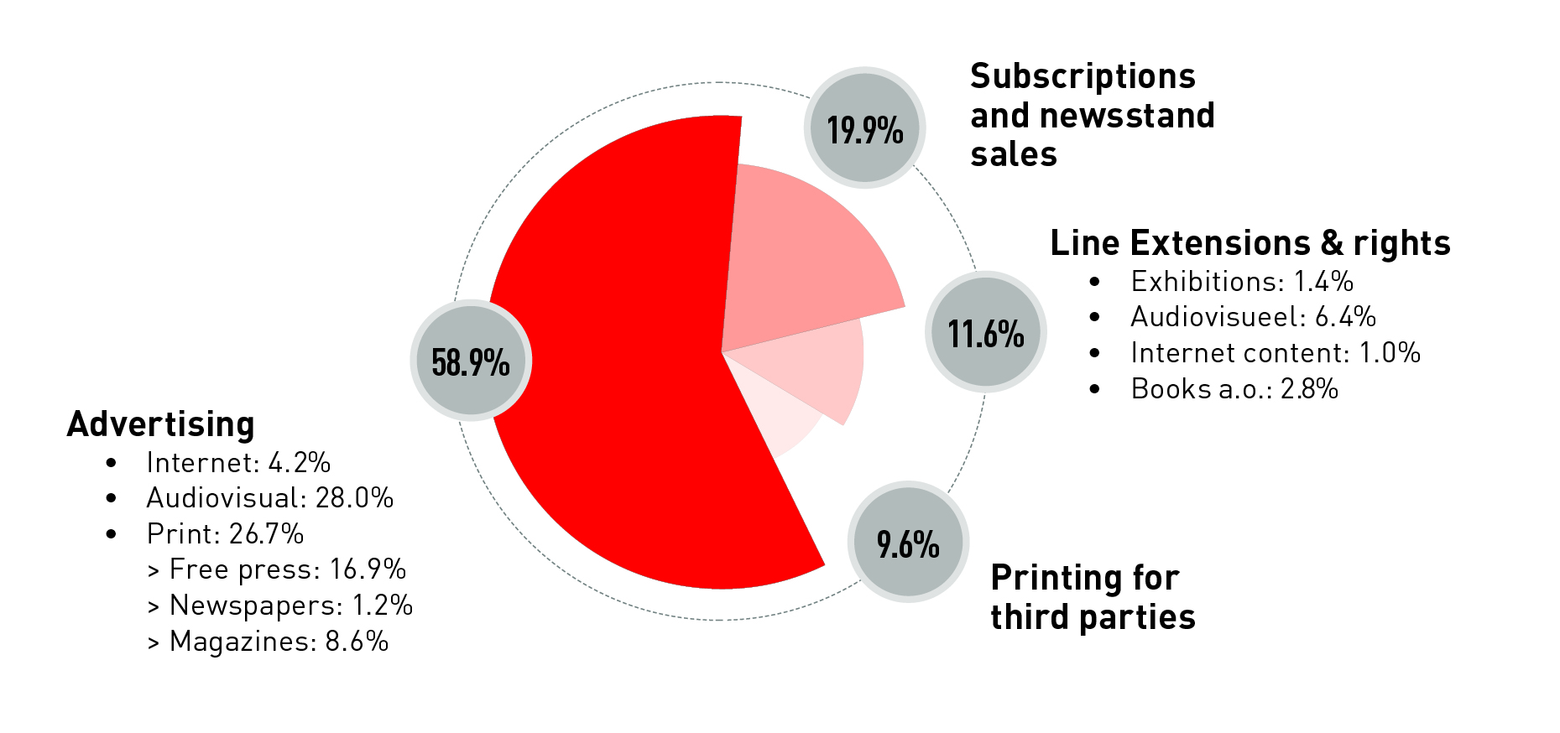
Sales analysis
(based on combined)
2017
232,7 mio €
2016
240,9 mio €

Slide 13
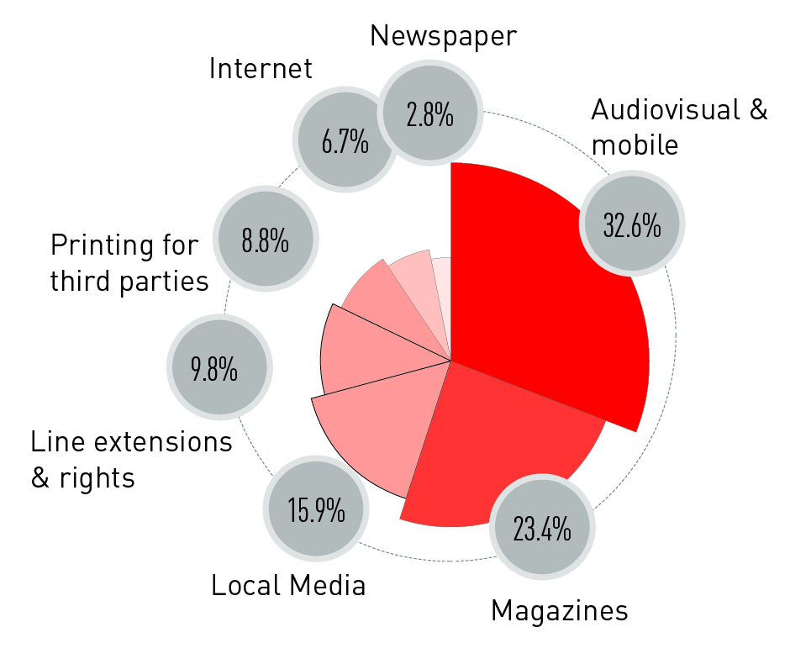
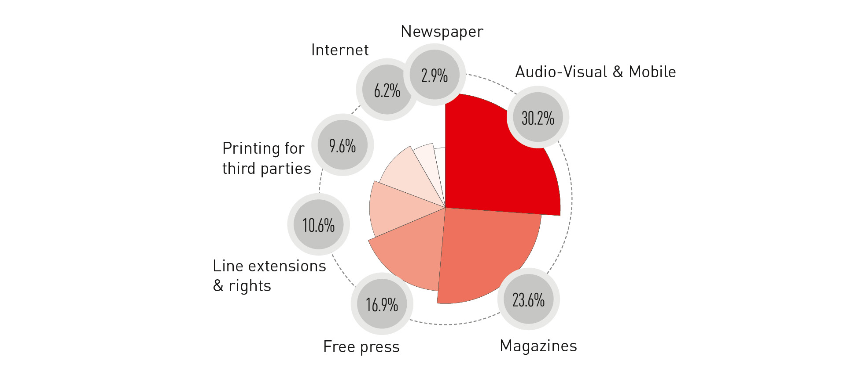
Sales analysis (based on combined)
2017
232,7 mio €
2016
240,9 mio €

Slide 14
2017 S1 KEY FIGURES
JEROEN MOUTON

Slide 15
Combined results 2017 S1 KEY FIGURES
(*)
(*) Including EBITDA of JV’s ( Medialaan, Plus, Germany, …)

Slide 16
Combined results 2017 S1 KEY FIGURES

Slide 17
Combined results 2017 S1 KEY FIGURES

Slide 18
Consolidated results 2017 S1 KEY FIGURES
(*)
(*) Including net result of JV’s ( Medialaan, Plus, Germany, … )

Slide 19
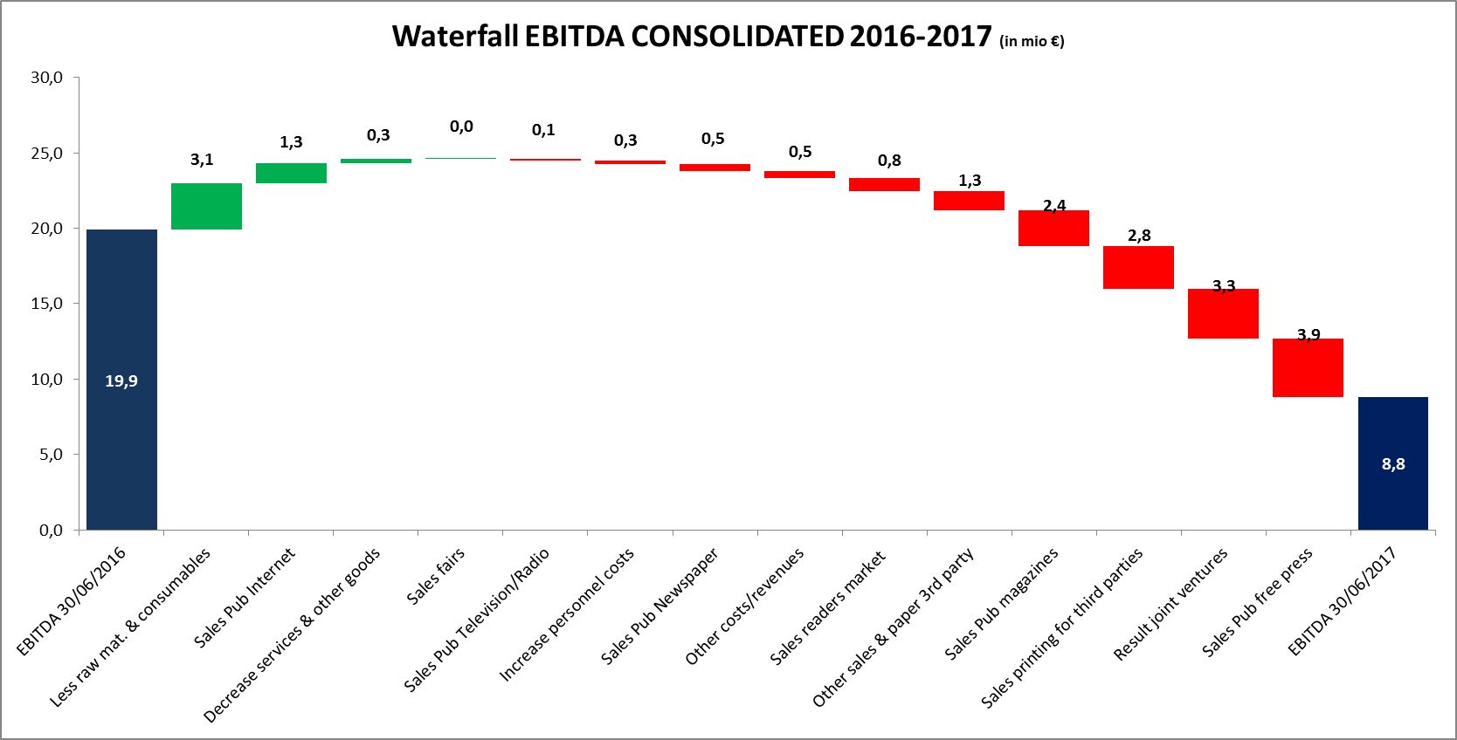
RESULTS 2017 S1 - KEY FIGURES (in €m)

Slide 20
RESULTS 2017 S1 – CASH FLOW STATEMENT (in €m)

Slide 21
RESULTS 2017 S1 - CAPEX (in €m)

Slide 22
Depreciations
The depreciations, 9,9 mio € in the combined figures of H1 2017, have increased with 2,7 mio € vs last year. This is mainly due to the depreciation of intangible assets for “titles” & PPA equaling +2,4 mio € & software +0,2 mio € and tangible assets for +0,2 mio €.
The +2,4 mio € consists out of Mobile Vikings, Lifestyle, “Inside Beleggen”, CAZ and some smaller titles.

Slide 23
Bank Covenants (based on combined figures)
Consolidated Balance Sheet

